Slide 1



Slide 2
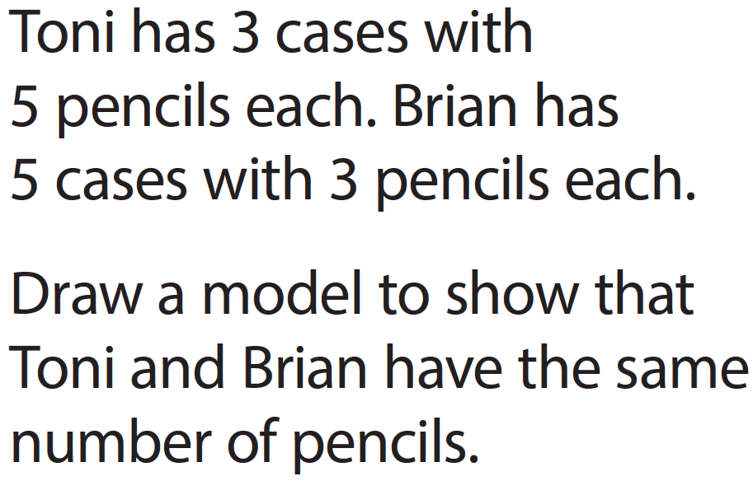

Slide 3
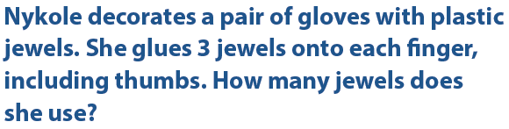

First Listen:
Second Listen:
Third Listen:

Slide 4

Nykole used _______ jewels.

Slide 5
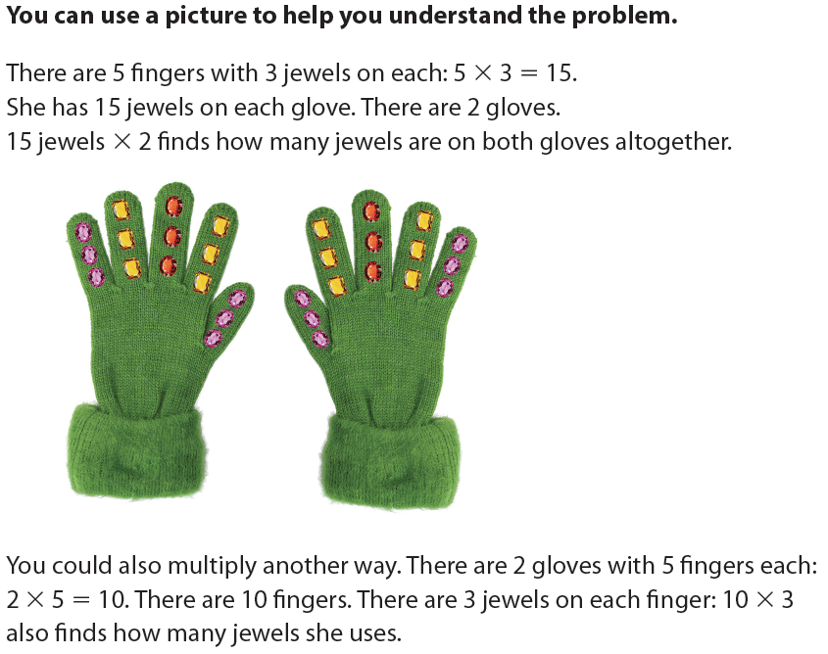

Slide 6
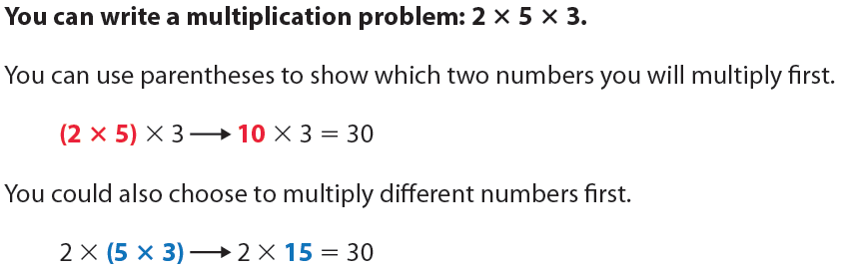

Slide 7
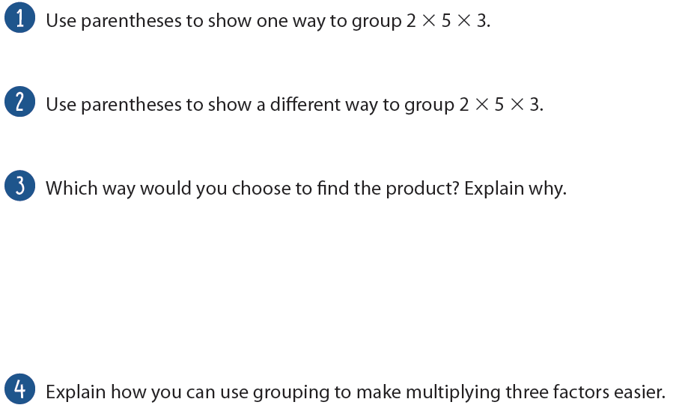

Slide 8
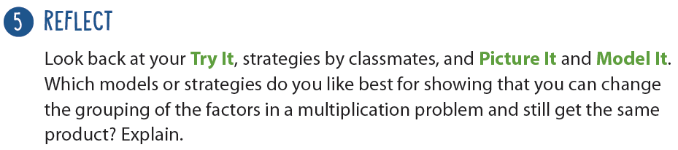

Slide 9


Slide 11
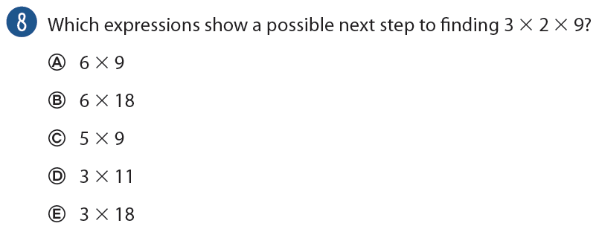
Hint: there is only 1 correct answer!

