Slide 2
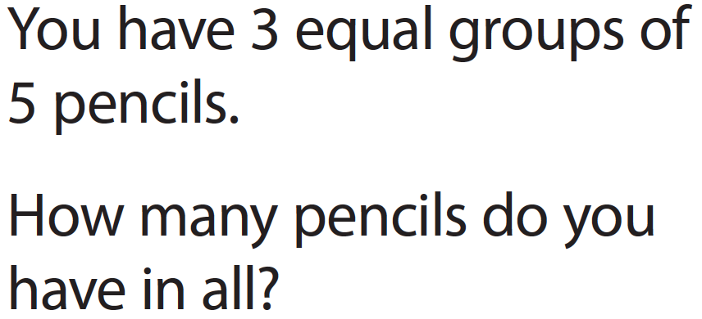
Show your work

Slide 3
Show your work

Slide 5
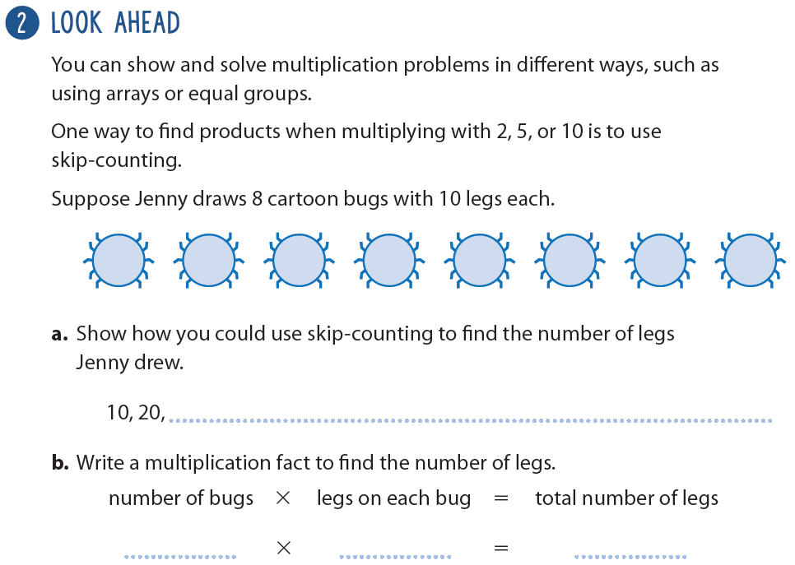

Slide 6
Show your work

